Slide 1


Oracle database
Lecture 17

Slide 2

Today’s Agenda
Introduction To ORDER BY Clause
Sorting Order Of ORDER BY
Sorting On Multiple Columns
Behavior Of DISTINCT And NULL In ORDER BY

Slide 3
The ORDER BY Clause
In Oracle , the data is not stored in a table in any particular order.
So , when we display data they happen to be returned from the database in any random order which the database decides.
However, we might want to view data in a certain order, and for this we can use the ORDER BY clause.

Slide 4
The Syntax Of ORDER BY
Syntax:
SELECT columns | expressions
FROM table
WHERE conditions
ORDER BY expression [ ASC | DESC ];
Parameters
Columns | expressions: It specifies columns that you want to retrieve.
tables: It specifies the table name from where you want to retrieve records.
conditions: It specifies the conditions that must be fulfilled for the records to be selected.
ORDER BY: The clause indicating that data is to be sorted
Expression: It specifies columns or expression on which sorting is to be done.
ASC: It is an optional parameter that is used to sort records in ascending order.
DESC: It is also an optional parameter that is used to sort records in descending order.
DEFAULT SORTING ORDER IS ASCENDING

Slide 5

Queries
WAQ to display ename and sal of employees in ascending order of sal.

Slide 6
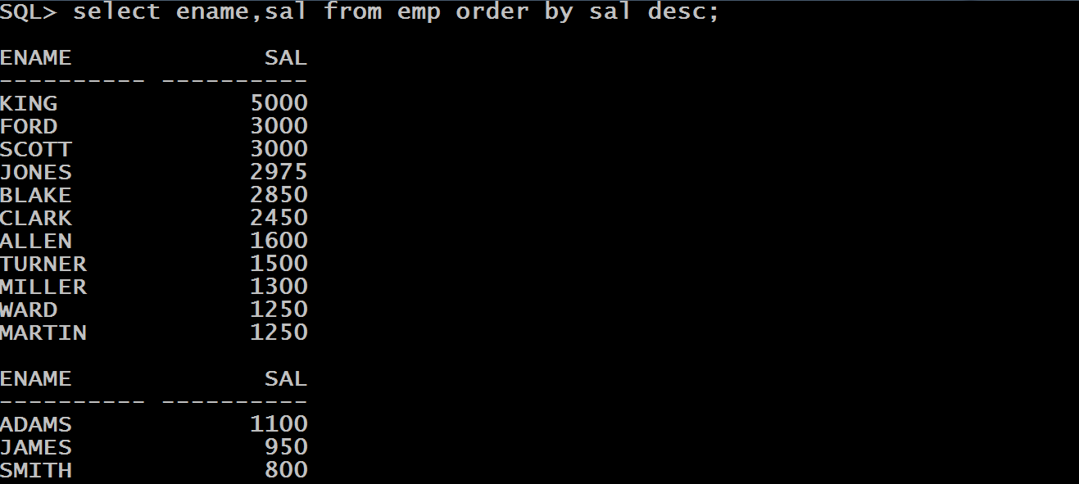
Queries
WAQ to display ename and sal of employees in desending order of sal.

Slide 7
Sorting On Col Position
Instead of listing the name of the column to be ordered, we can list the sequence number of the column in the SELECT list.
The next SQL statement returns the same result as the first example but uses a different ORDER BY clause.

Slide 8
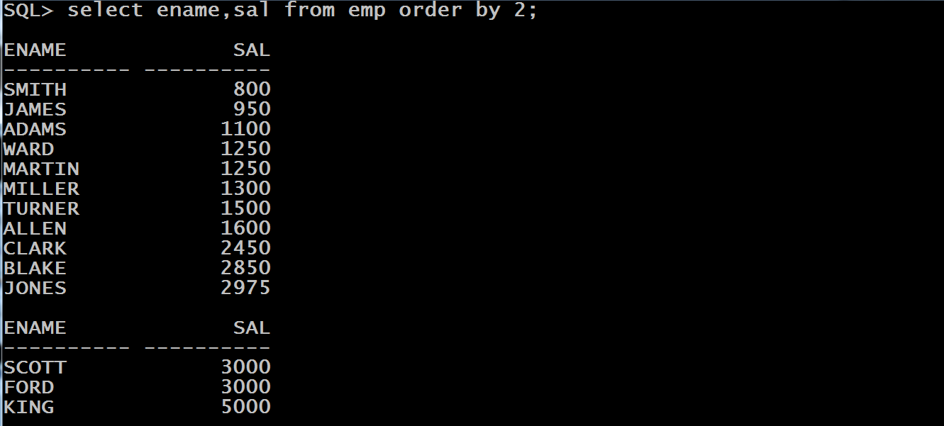
Sorting On Col Position
The number 2 indicates the second column of the SELECT list.

Slide 9
Sorting On Multiple Cols
A result set can be sorted by more than one column.
The columns we want to sort by need only be included in the ORDER BY clause, separated by commas.
In this case Oracle will first sort on the basis of first column and if it finds a duplicate value in first column then it considers the second mentioned column

Slide 10
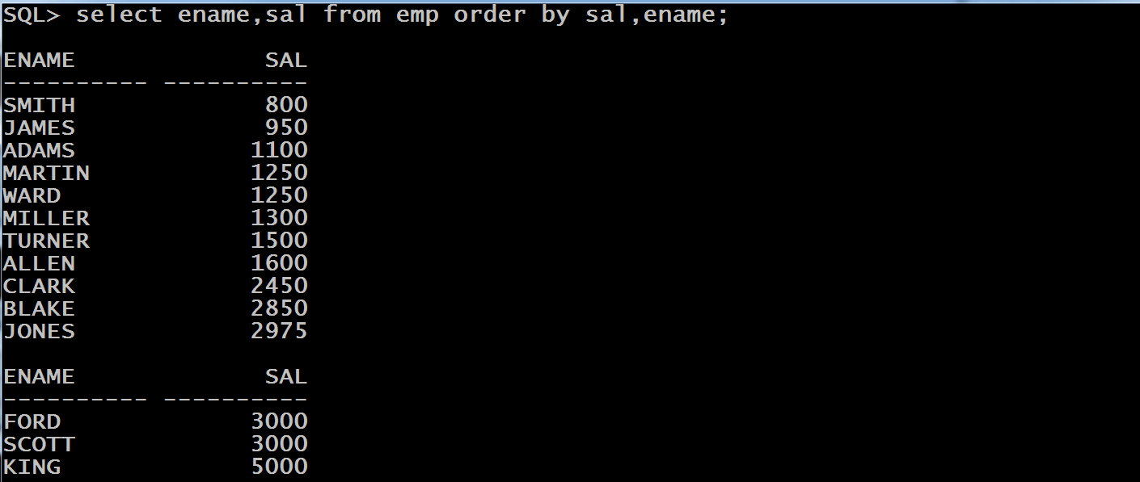
Sorting On Multiple Cols
The above query first sorts on SAL and wherever SAL is same , it considers ASCENDING ORDER of ENAME

Slide 11
DISTINCT And ORDER BY
The ORDER BY clause often contains columns listed in the SELECT clause, but it is also possible to use ORDER BY on columns that are not selected.
One exception is columns qualified using the DISTINCT keyword:
If the SELECT list contains DISTINCT, then the ORDER BY clause can only contain those columns which are a part of SELECT not any other column

Slide 12

DISTINCT And ORDER BY
The next example shows that the DEPTNO column is not a column listed in the DISTINCT SELECT list and therefore results in an Oracle error message.

Slide 13
NULL And ORDER BY
By default if the column on which sorting is being done contains NULL values then Oracle places NULL values at the end.
The query on next slide orders the COMM column and all the row with a COMM column value of NULL become the trailing rows in the sort order.

Slide 14
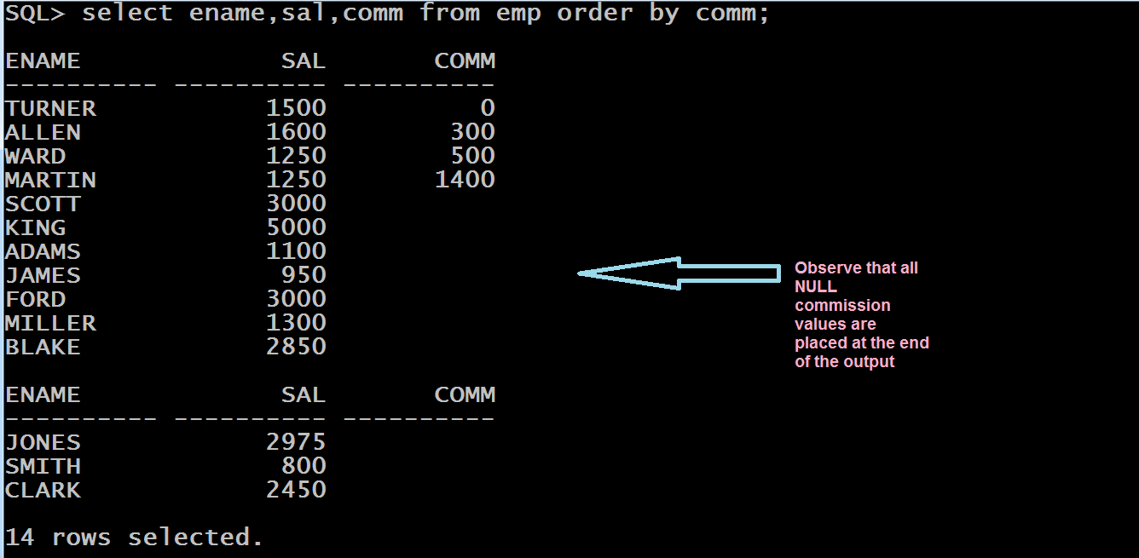
NULL And ORDER BY

Slide 15
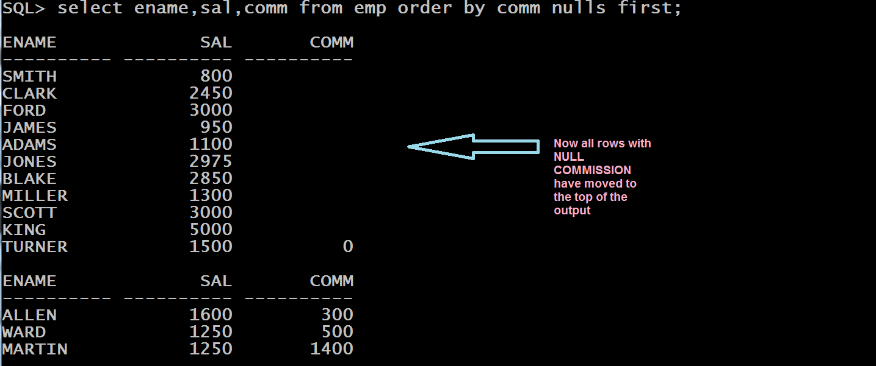
NULL And ORDER BY
We can change the ordering of the NULLs with the option NULLS FIRST or NULLS LAST in the ORDER BY clause, as shown in the next statement

